Slide 1
TankInATank
10/17/2017-Iteration 1
Team 1 - Postponer
Present Today:
Shuhan Liu, Haotian Wu,
Baoxiang Yang, Lei Yang

Slide 2
Overview
Map Scene
Tank Creation and control
Camera
Further Moves
Basic Function: shoot
Topic Today

Slide 3
Overview
2.5D local multiplayer tank fighting game in Unity3D
Finished So far:
Map Scene
Tank Creation and Control
Camera Set
Shoot function

Slide 4
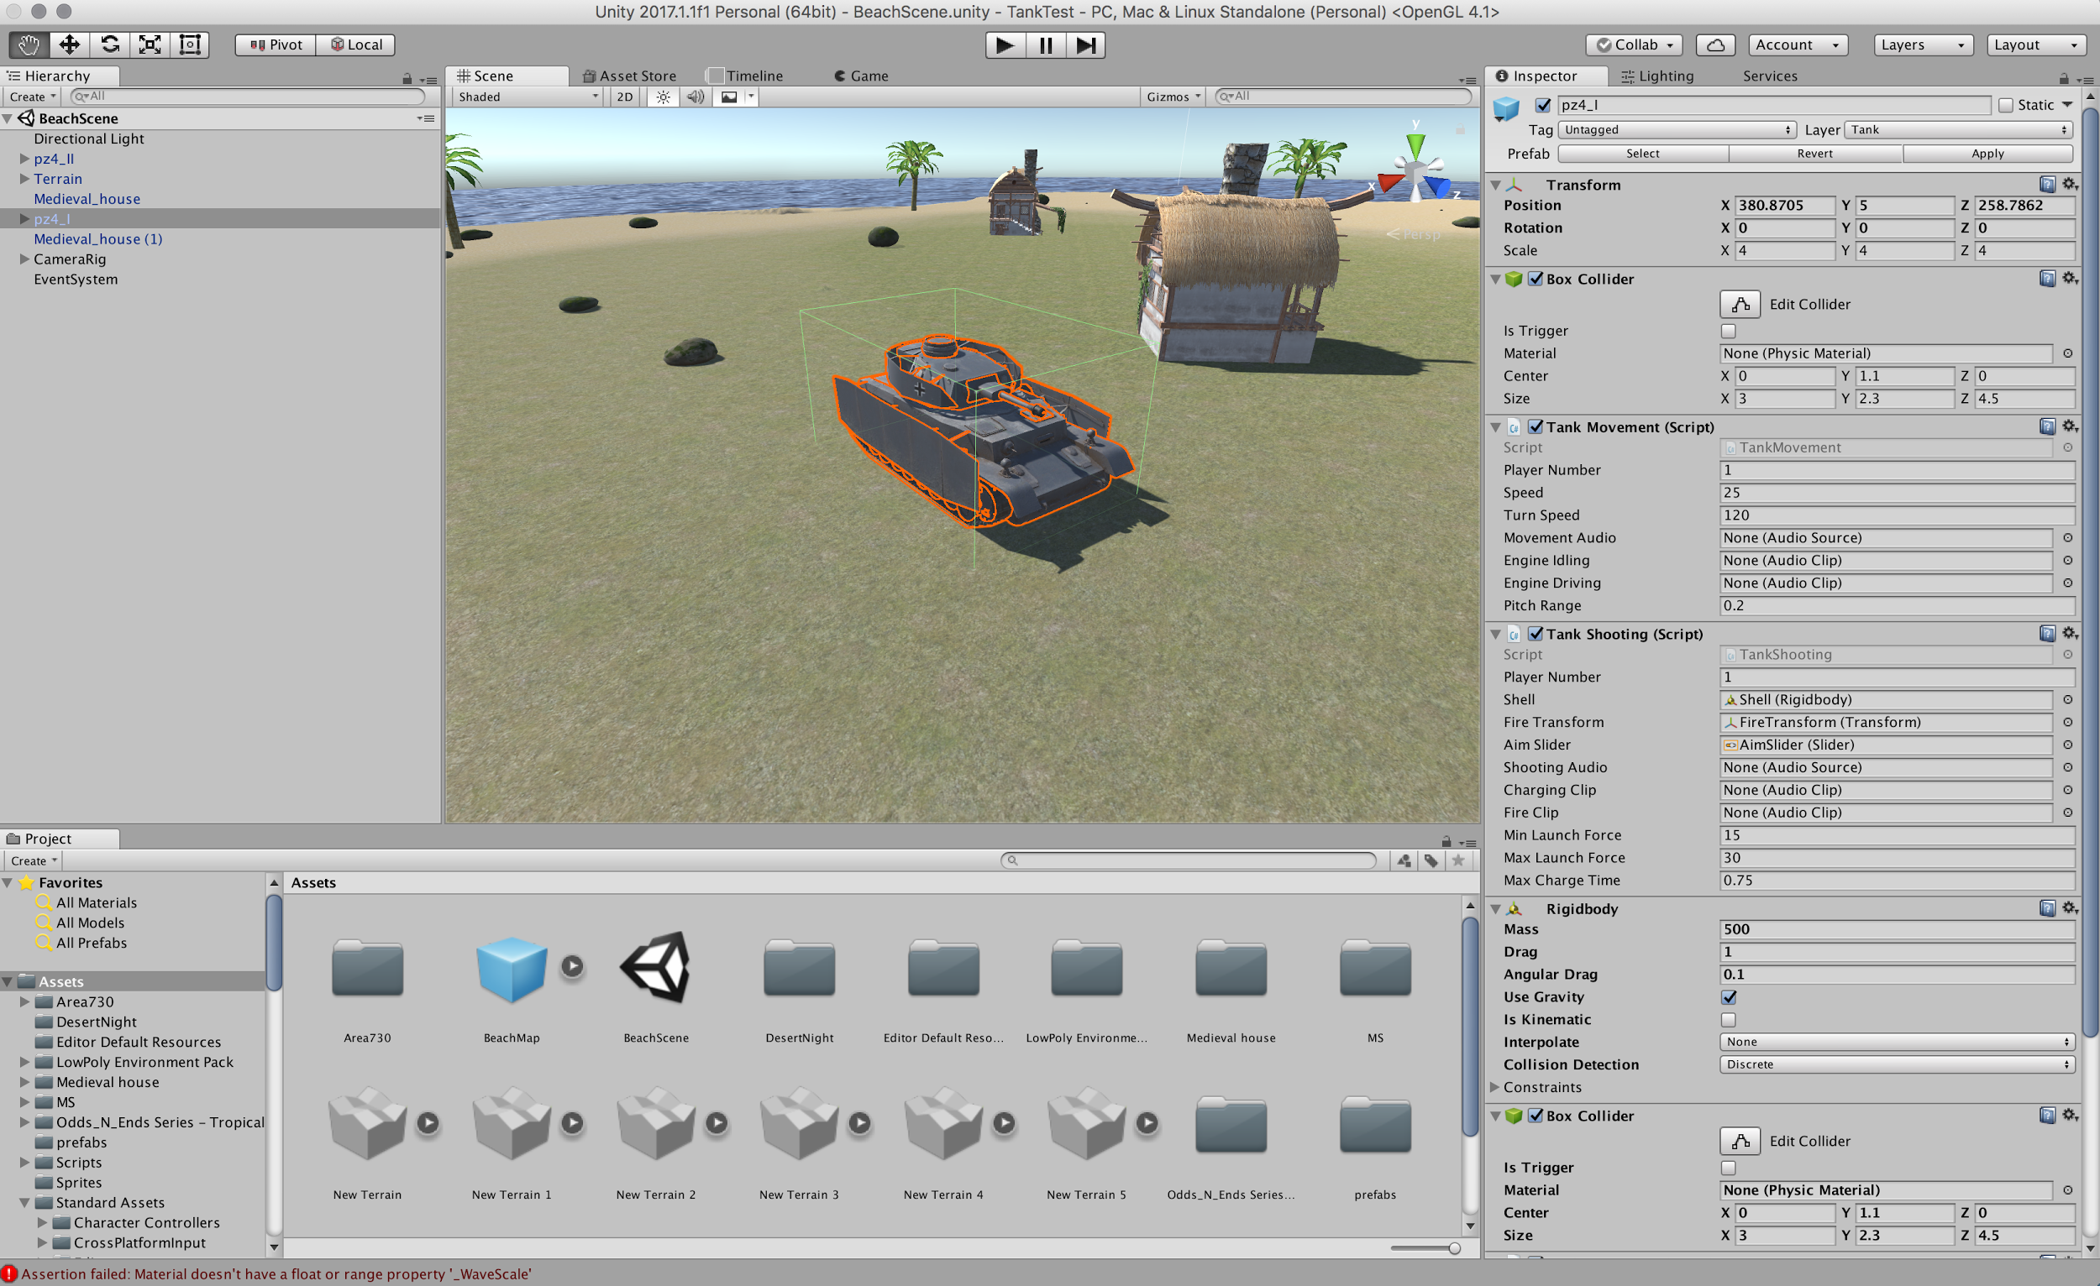
Project Setup

Slide 5
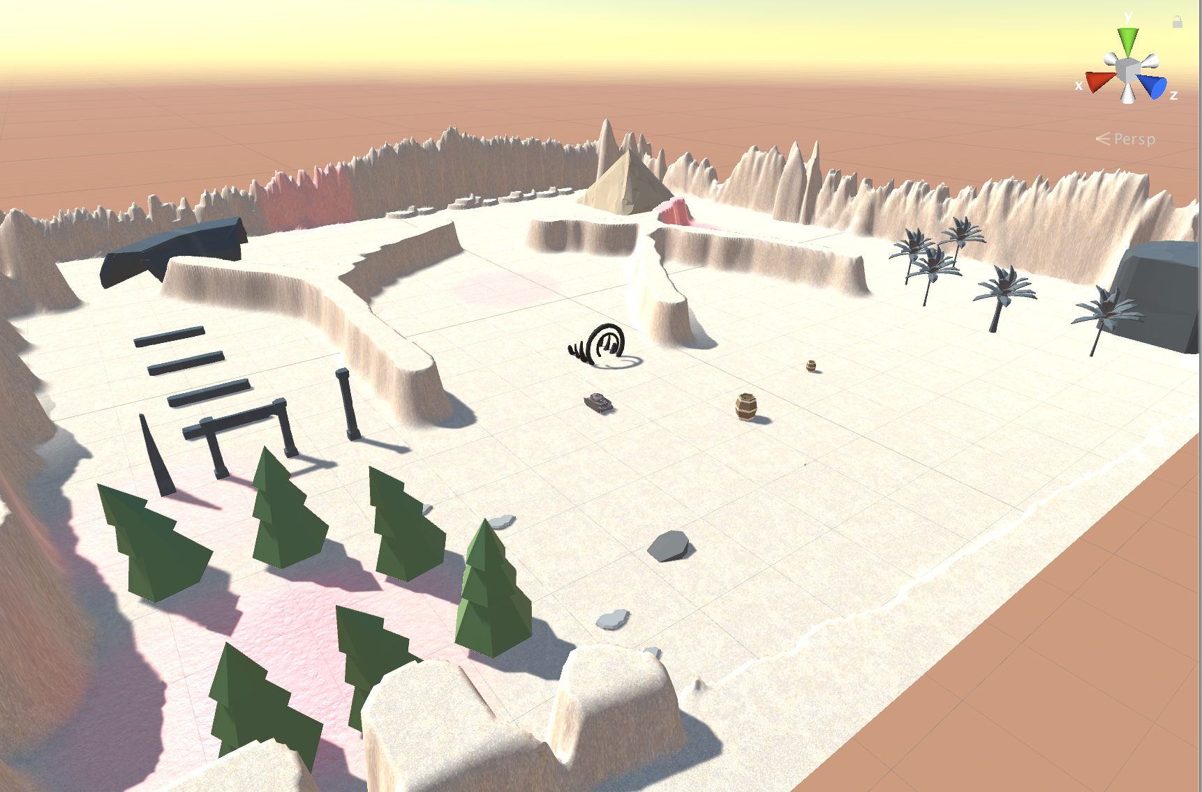
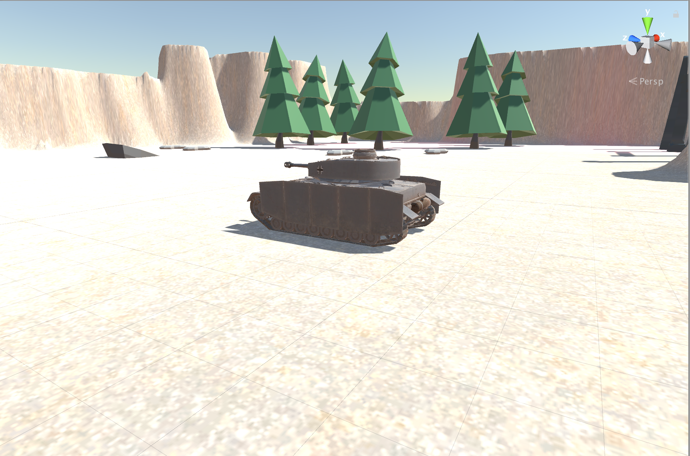
Map Scene - Multiple maps
Basic Test Map: Beach
Development:
Desert Map: XY Desert
Forest Map: Forest
City Map: Destroyed City

Slide 6
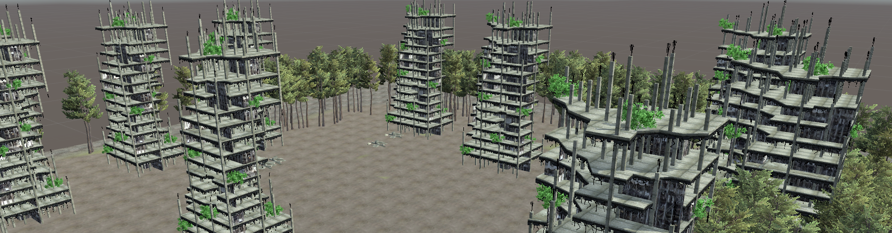
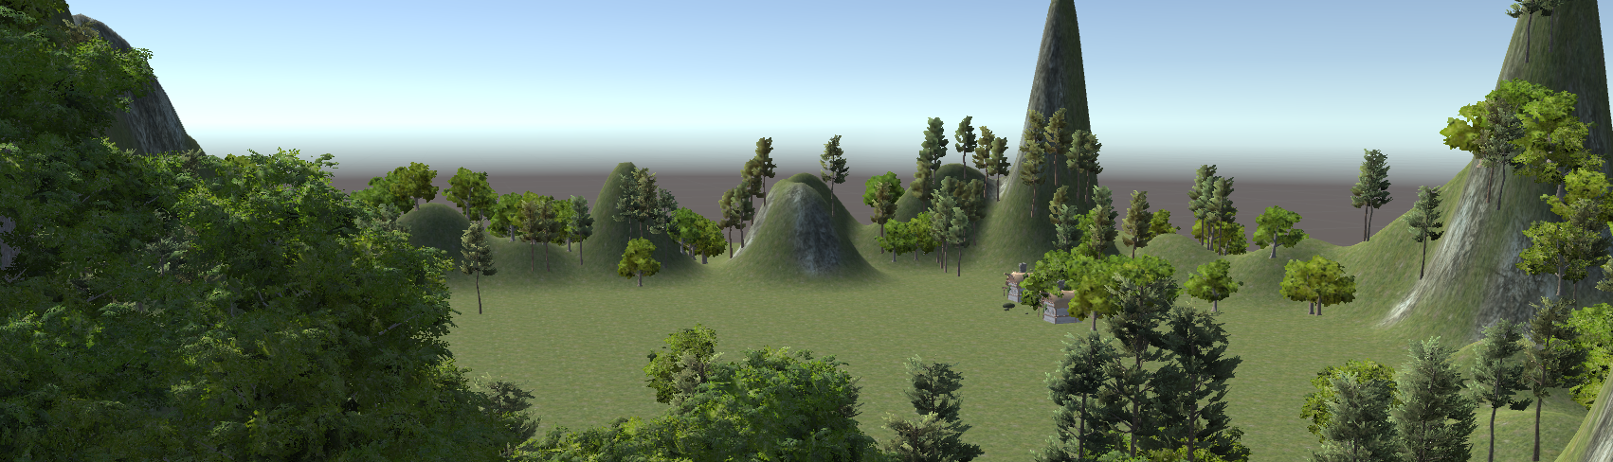
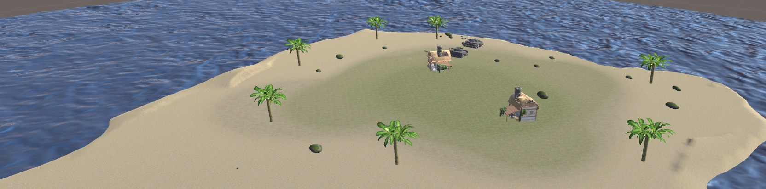
Map Scene - Multiple maps

Slide 7
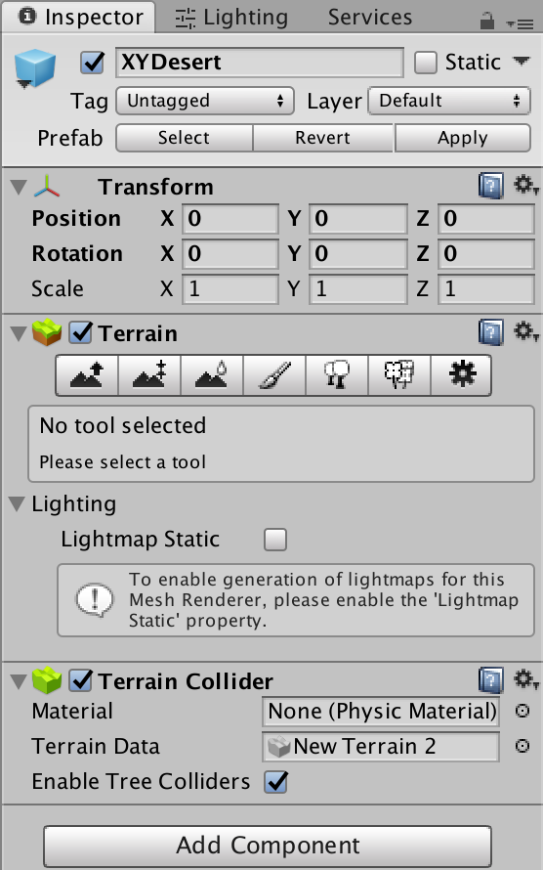
Map Scene - Basic key concepts
Lighting
Materials, Shaders & Textures
Create Terrains:
Height Tools
Terrain Textures
Paint Brush
Trees
Grass and Other Details:
Asset Store!

Slide 8
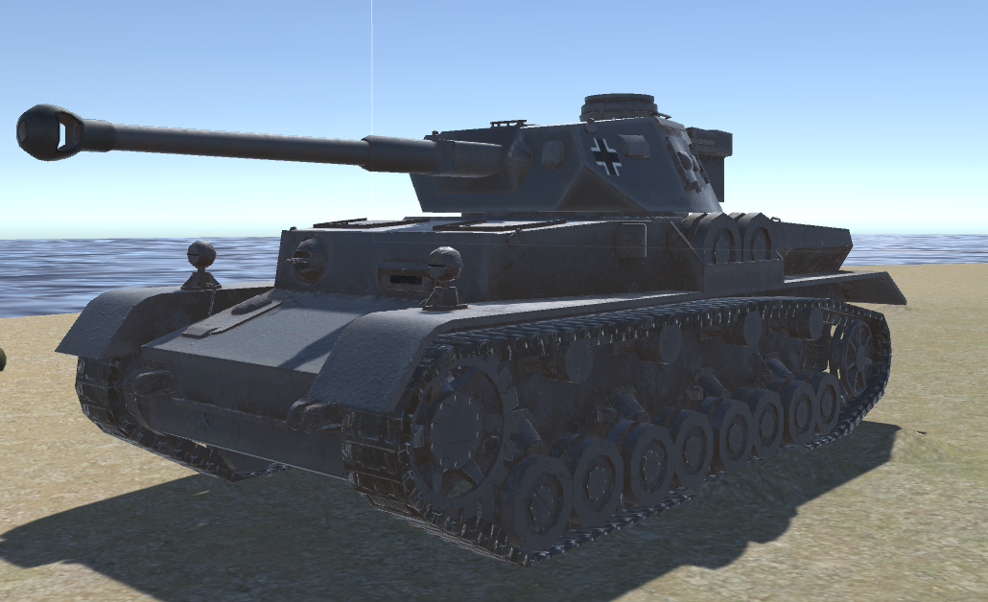
Tank control and Creation
Tank model is downloaded from Asset Store.
We wrote a script to get input from keyboard and transform it to movement in the game.

Slide 9
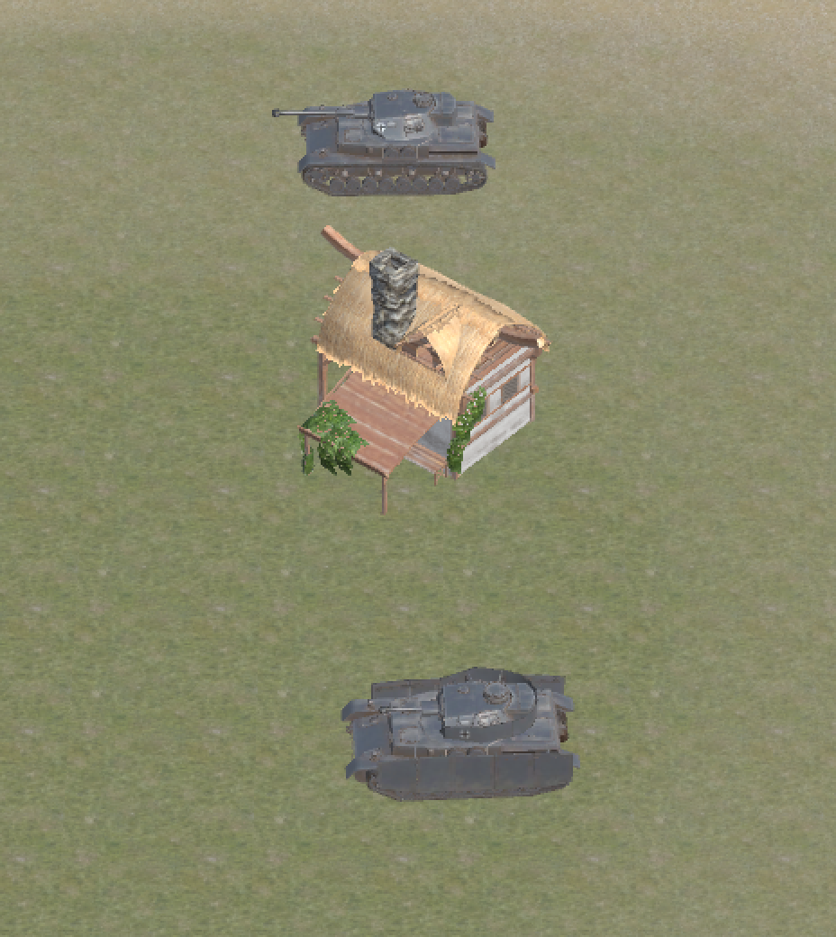
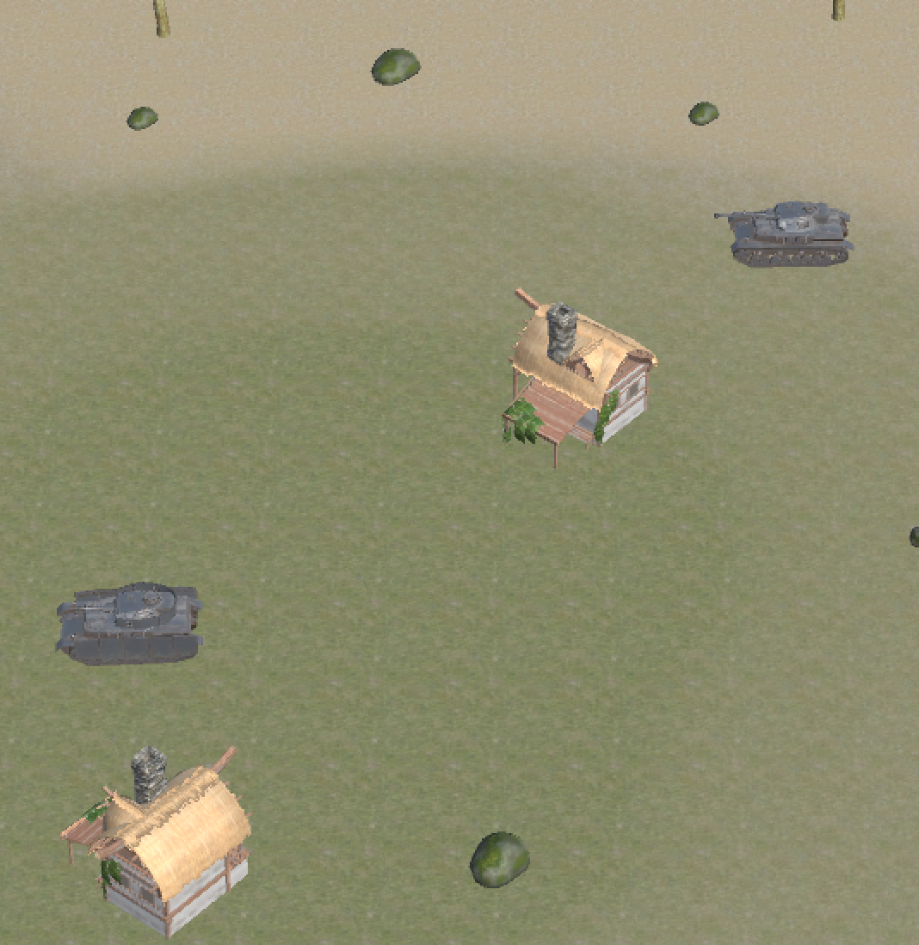
Camera
Camera will keep calculating the average position of two tanks during the game and focus on it.
Camera will automatically zoom in/out depends on the distance of two tanks.

Slide 10
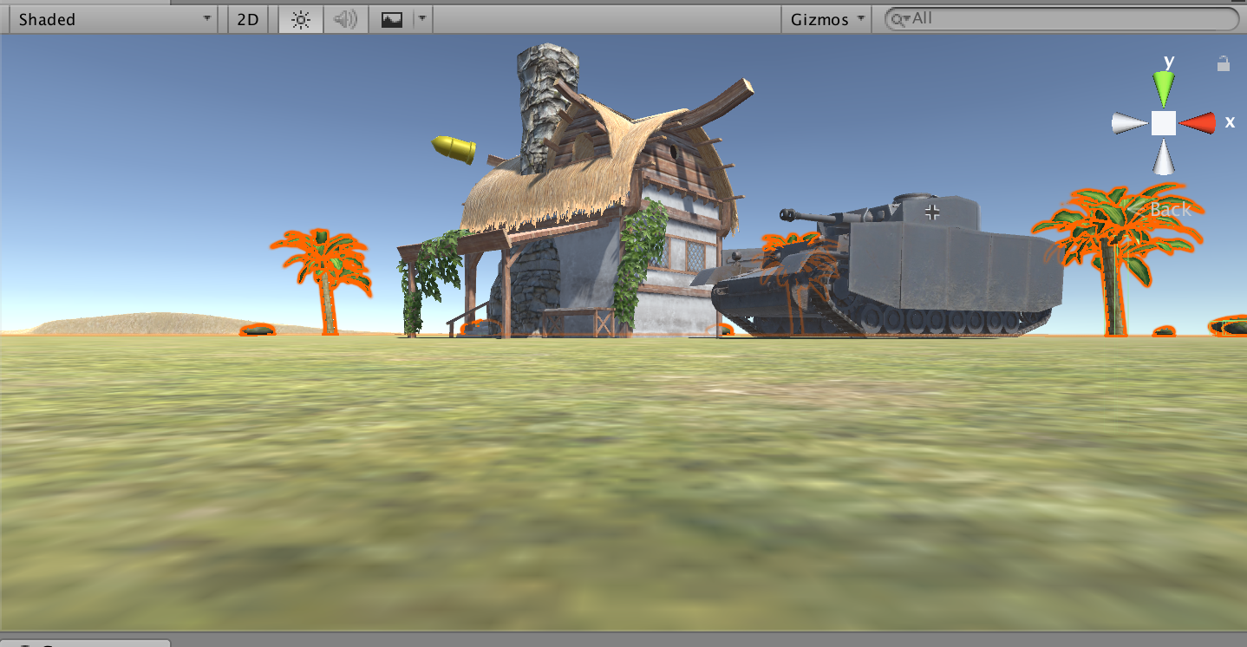
Basic Function: shoot
Indie Games:
Each shell is a prefab.
Explosion effect is triggered when the shell hits an object.
Shells can fly farther if you hold the fire button longer.
Test implemented: Boundary Value Testing, Beta Testing

Slide 11
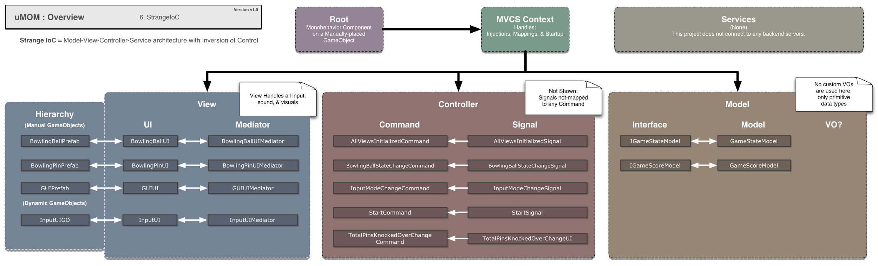
ARCHITECTURE

Slide 12
METRICS
Code coverage: 85% EMMA
Total Code lines: 4000+
Hours per week: 8/Person

Slide 13
Further moves
Goals for Iteration 2:
Apply the basic maps to all the maps we built.
Import HP to Tank
Import skills to Tank
Optimize maps appearance
Introduce test on C# code
TBD

Slide 14
Q&A
10/17/2017
Team 1 - Postponer
Linlan Chen, Shuhan Liu, Haotian Wu,
Baoxiang Yang, Lei Yang, Qiwei Zheng

